Slide 1
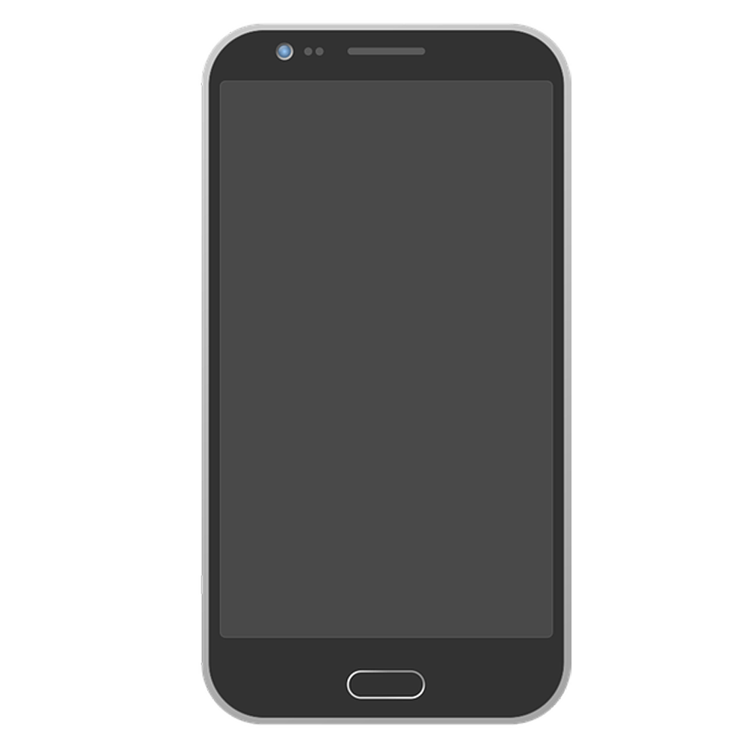
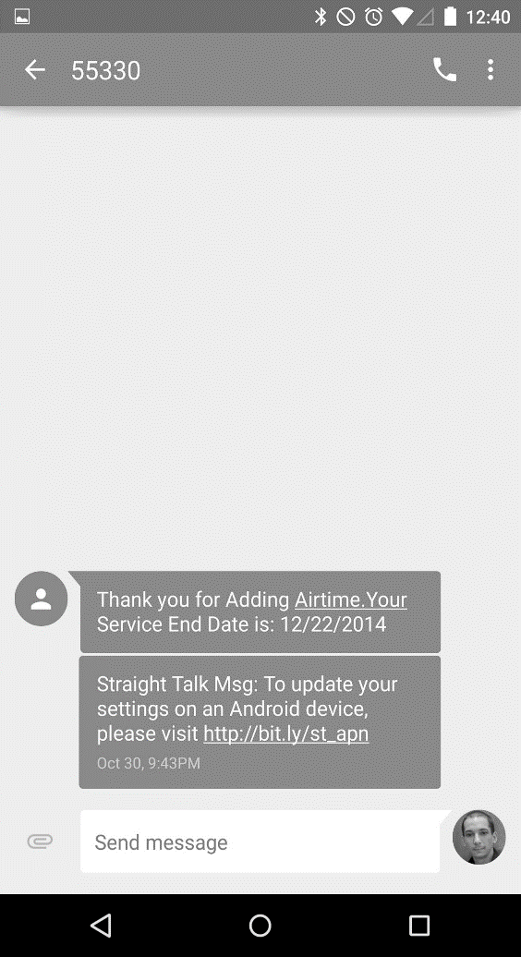

Emoji Checker
Emoji Checker
Log In
Avneet Sethi, Riyan Imam,
Michael Wheeler, Jocelyn Lopez,
Storm Simpson
Sign Up

Slide 2
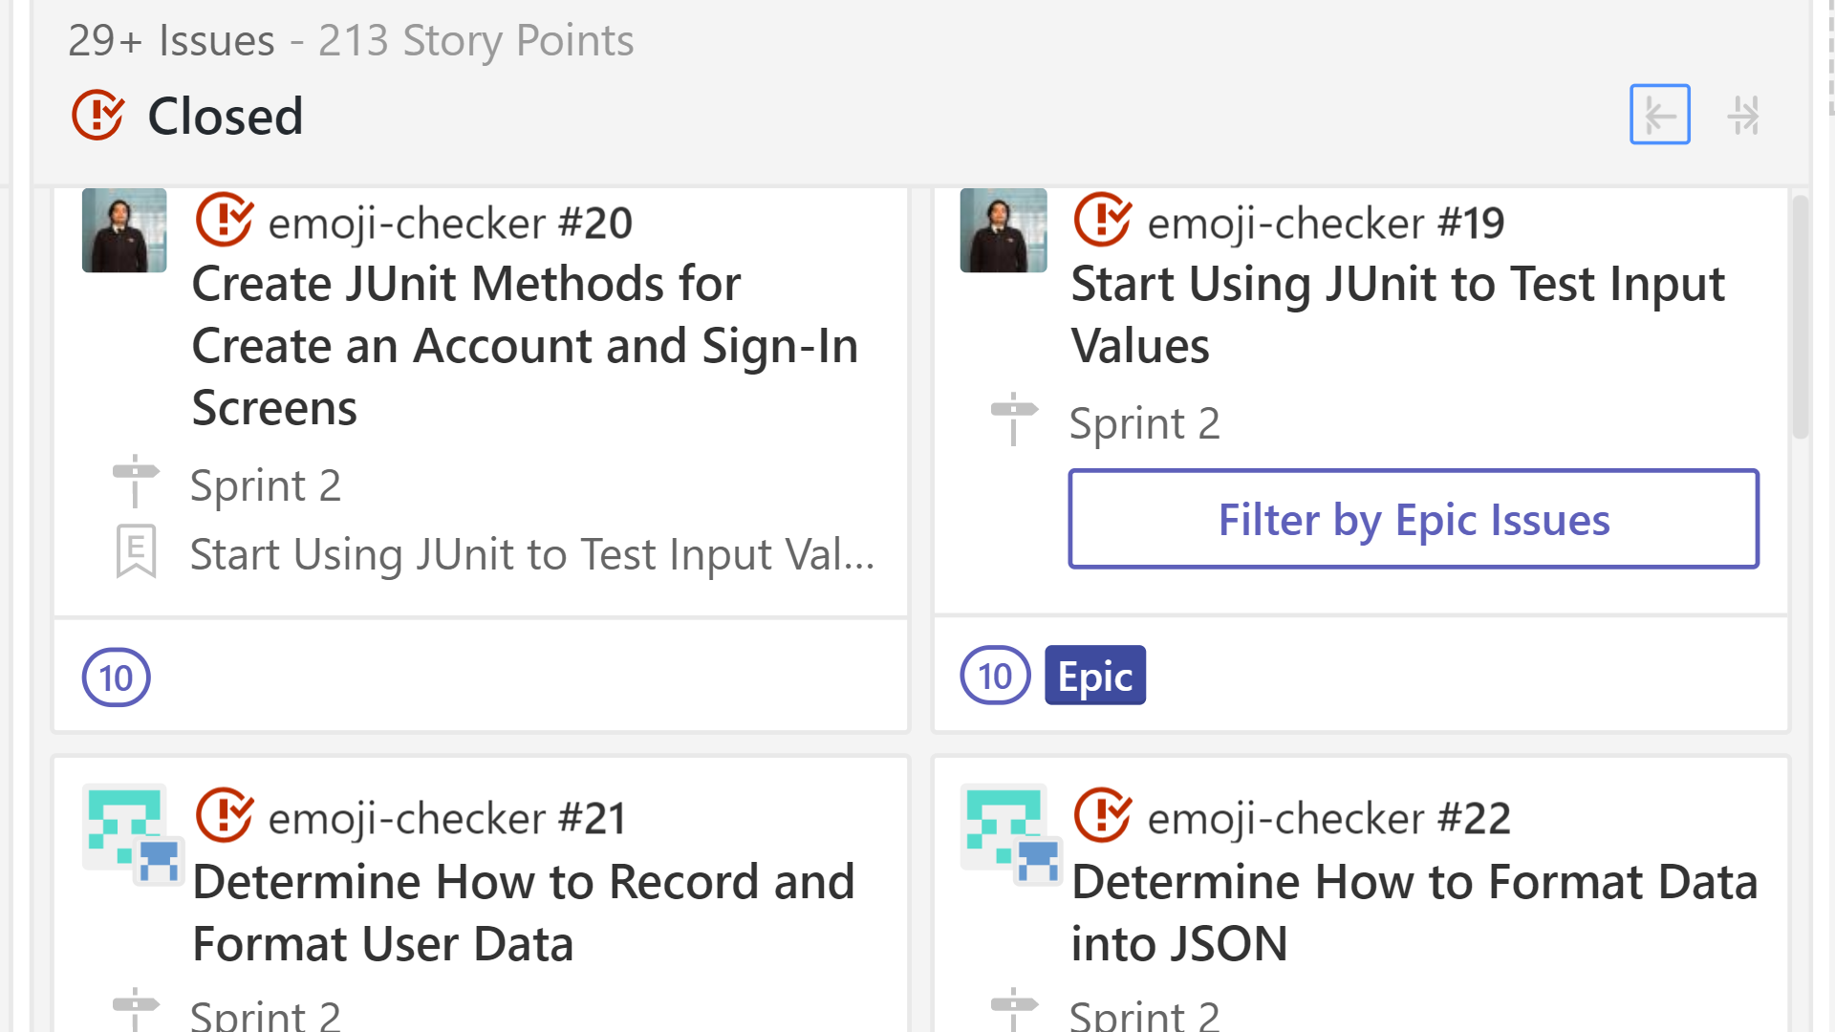
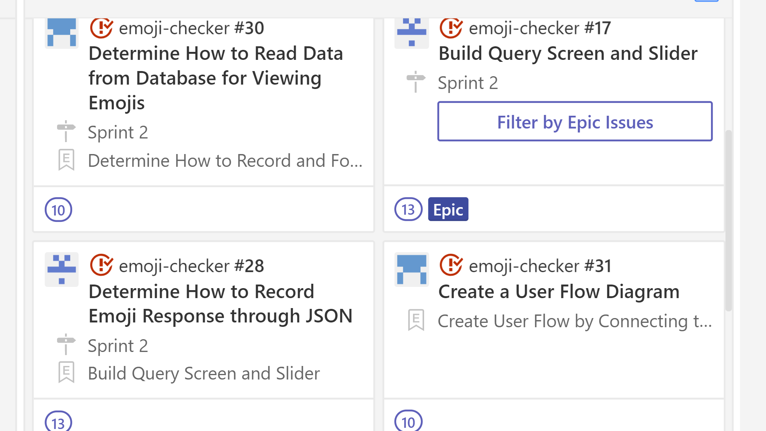
The Story So Far …
Completed Story Cards
Begin Junit Testing
Determine Recording of data
Query Screen & Slider
Correct Slider Functionality
Map Emojis to Keyboard

Slide 3
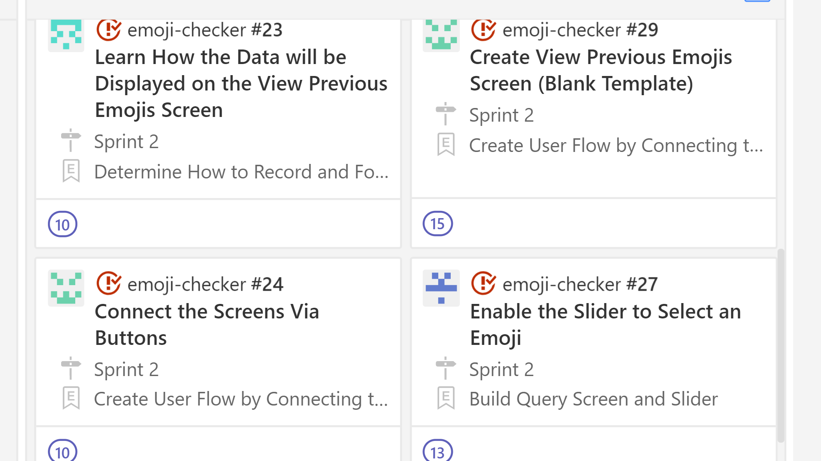
The Story So Far …
Completed Story Cards
View Prev. Emojis Template
How Data Will Appear
JSON Format
Test Cases

Slide 4
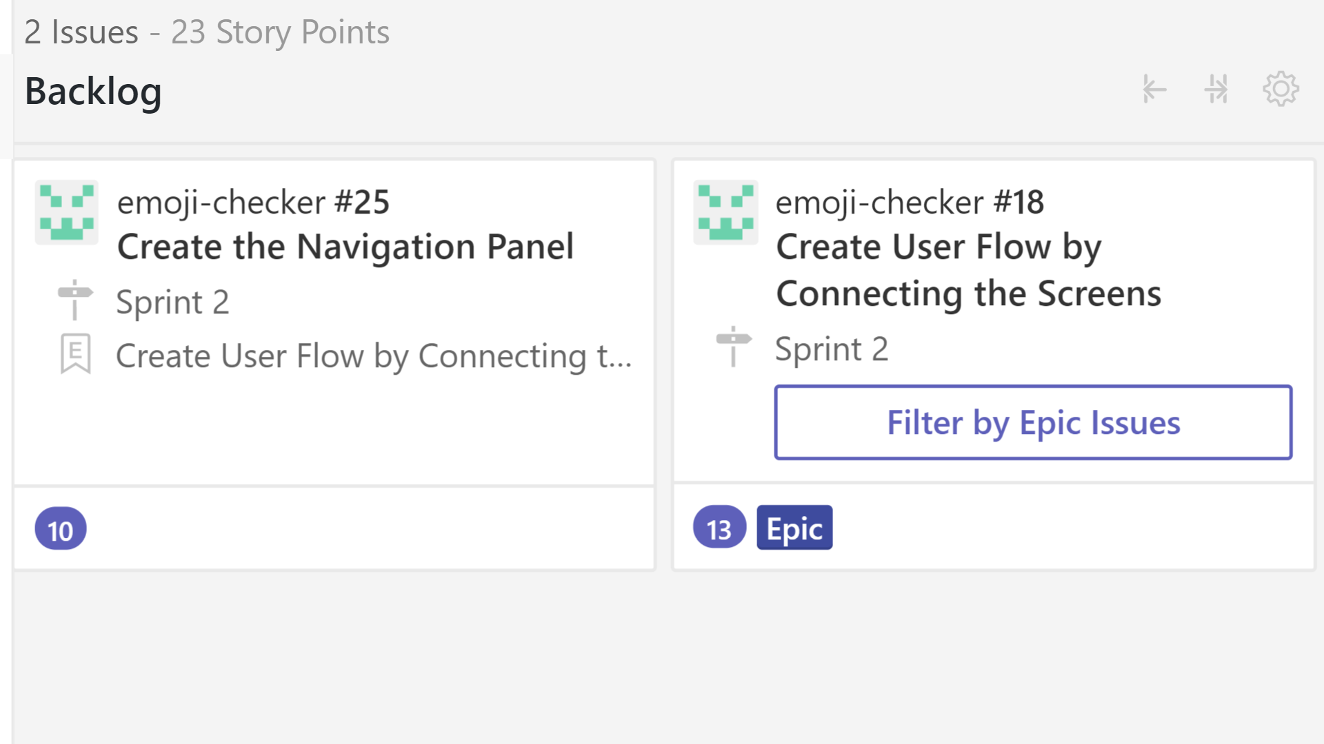
The Story So Far …
Backlog
Create User Flow
Connect User Screens

Slide 5
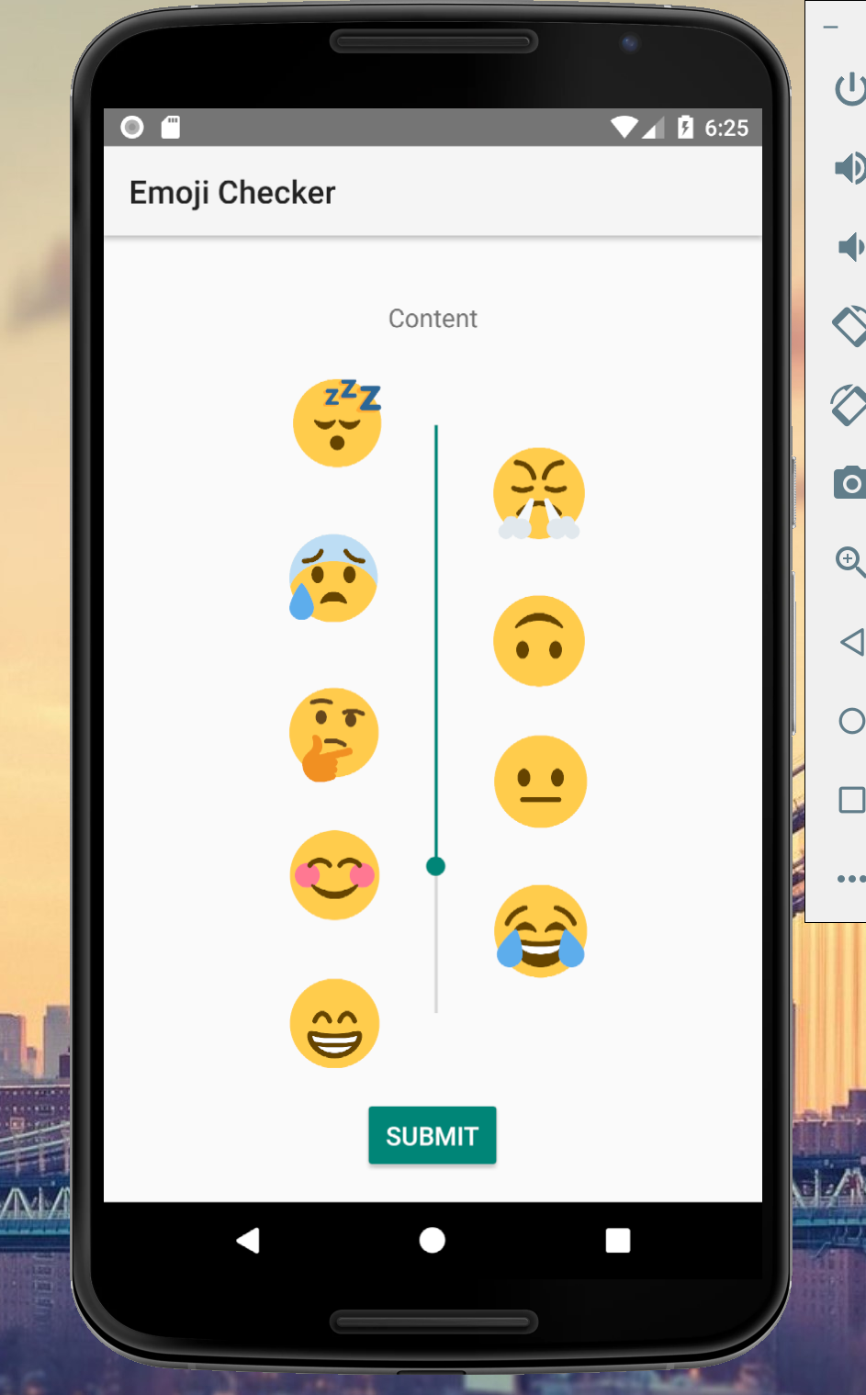
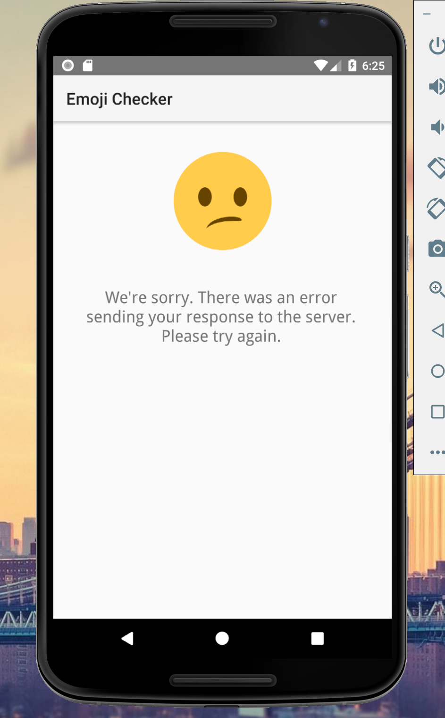
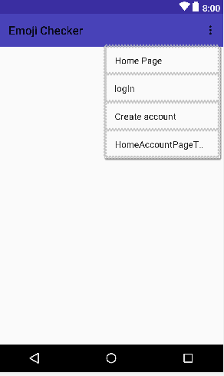
The Story So Far …

Slide 6
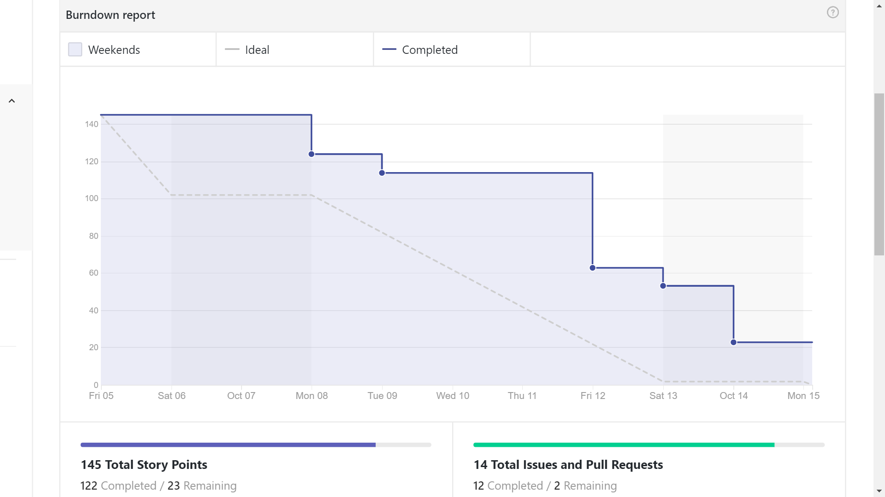

Slide 7
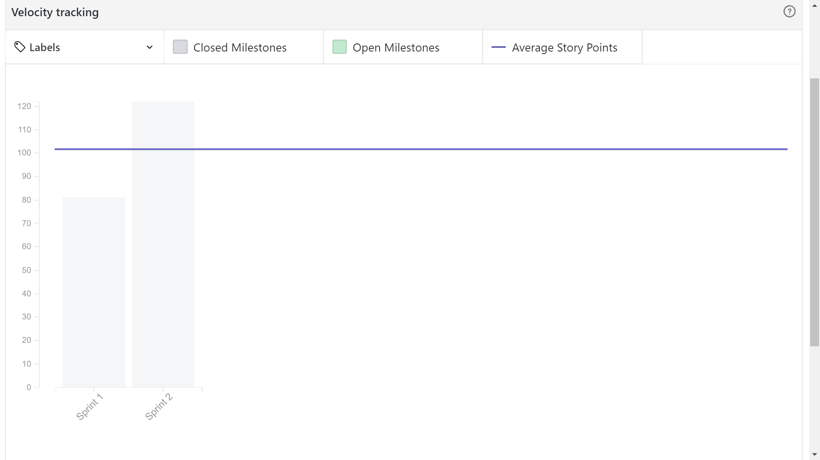

Slide 8
Architectural Design Patterns

Slide 9

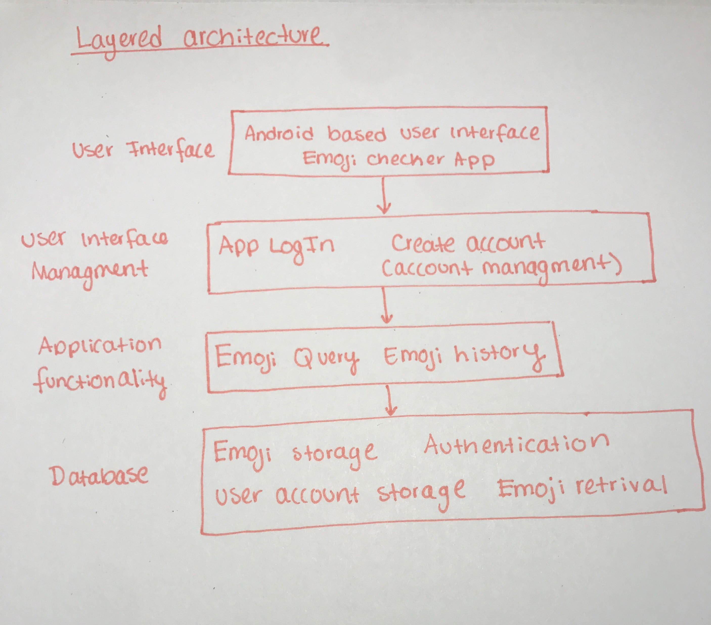
Layered Architecture

Slide 10
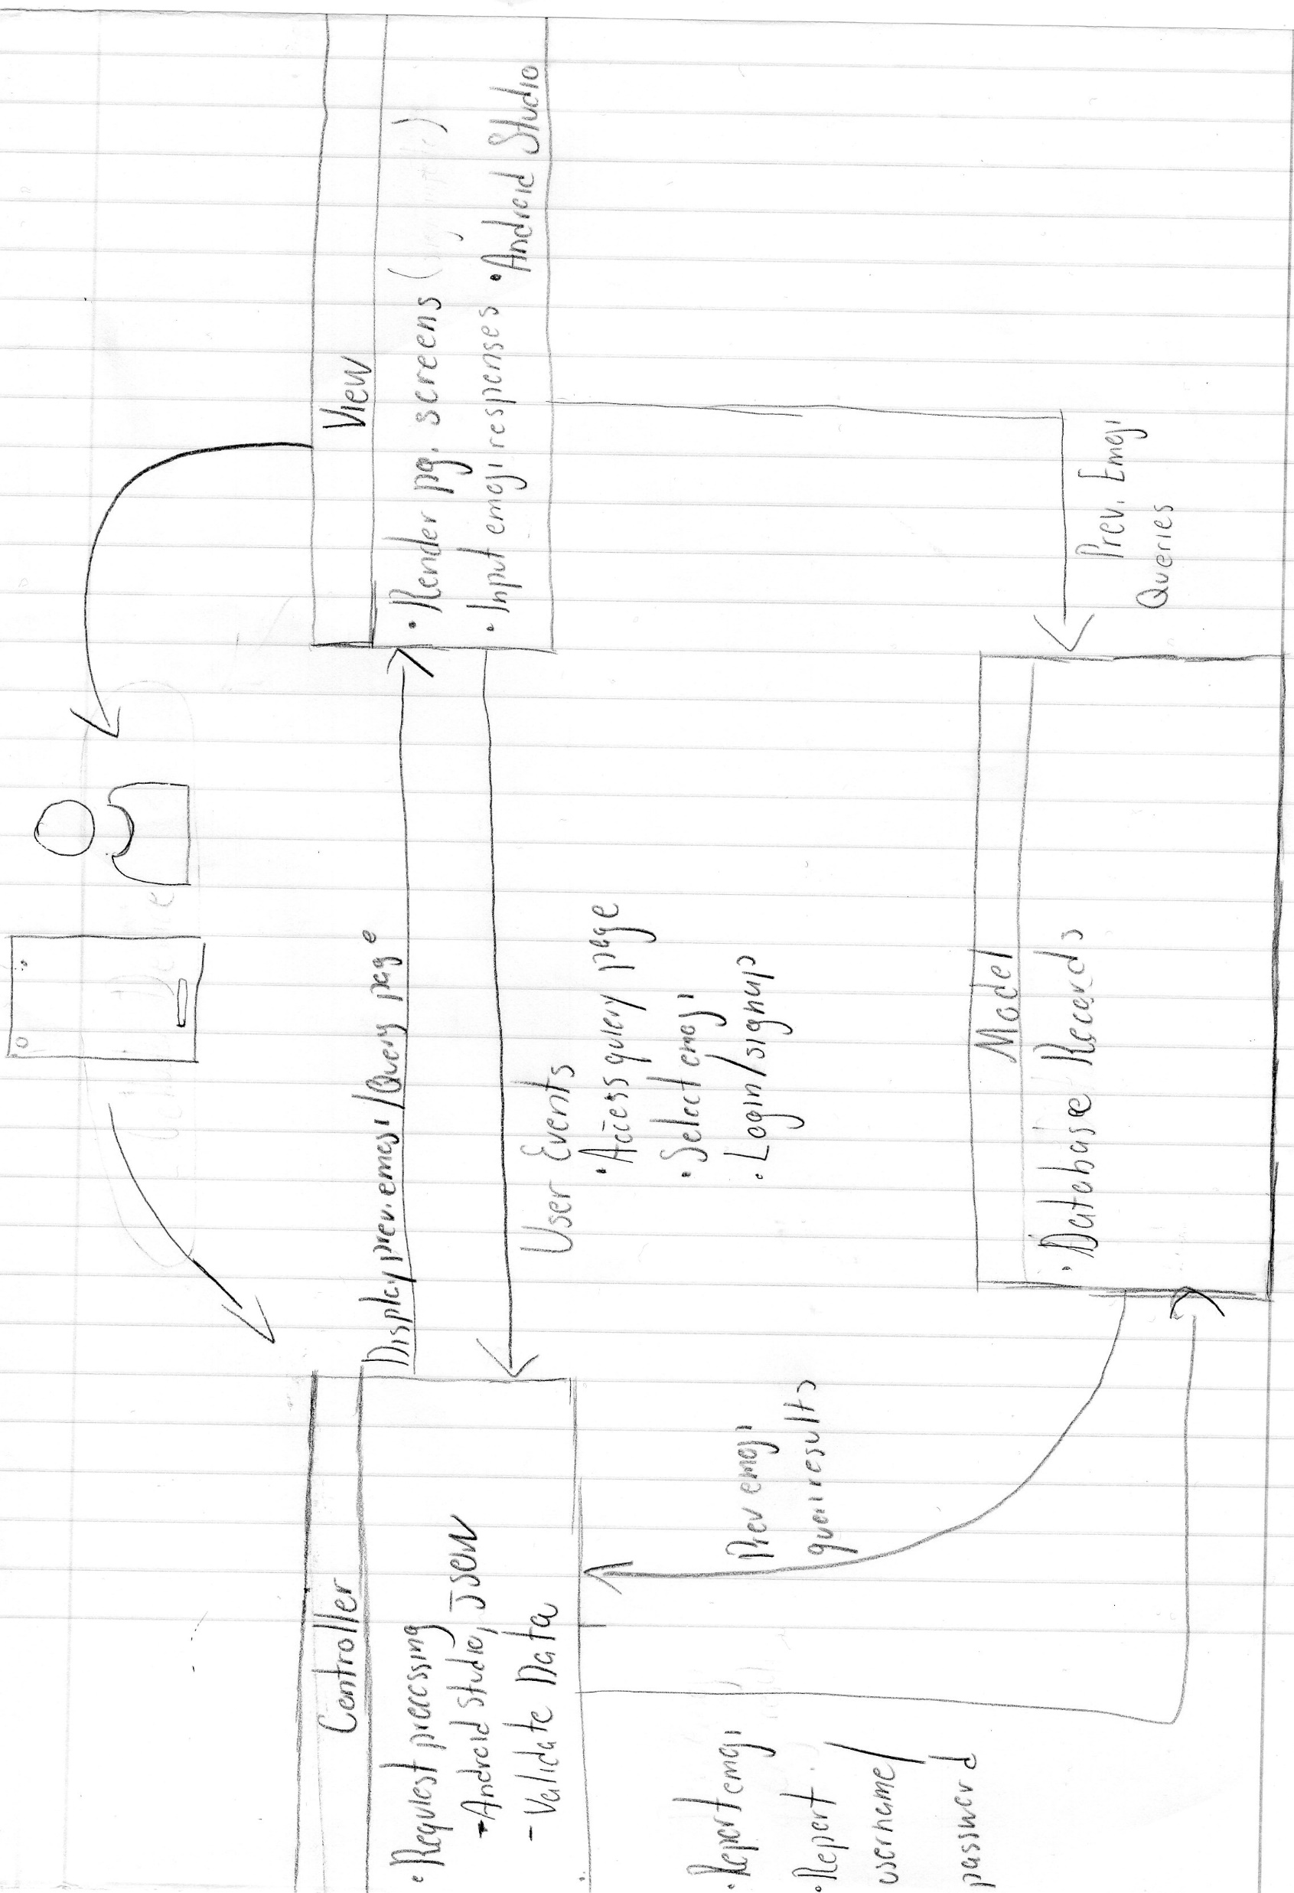

MVC Architecture

Slide 11
Interface User Model

Slide 12
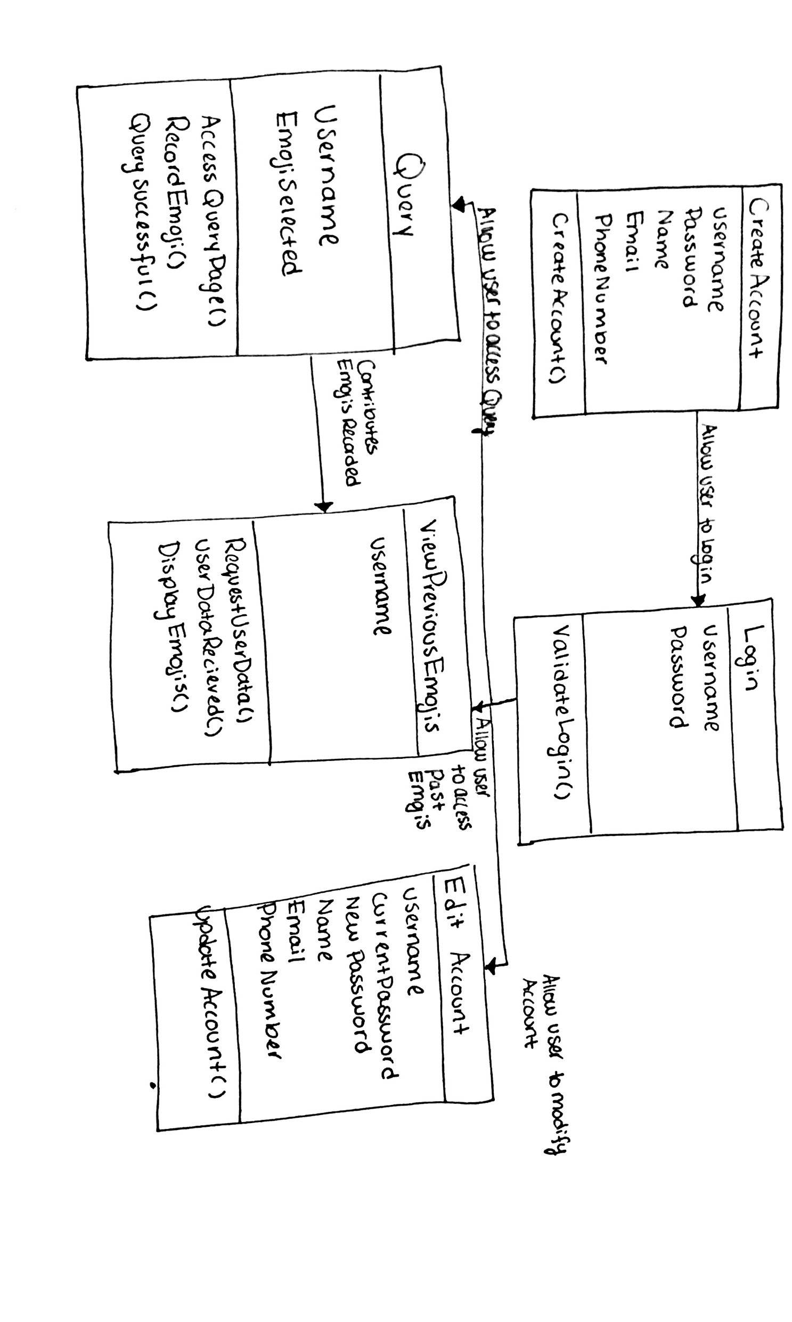

Slide 13

Plans for Sprint 3
Restricting access to the query page
Screens for account settings
Certify user flow between app screens
Connecting to database

